Slide 1
Reductions in photosynthetic nitrogen demand due to elevated CO₂ increases simulated future ecosystem carbon storage
Nick Smith (Texas Tech University; nick.smith@ttu.edu)
Qing Zhu, Bill Riley, and Trevor Keenan (Berkeley Lab)

Slide 2
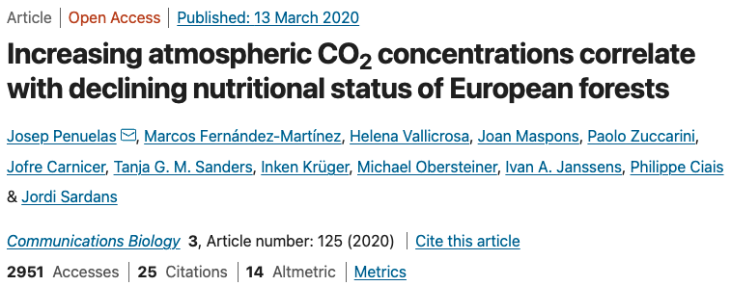
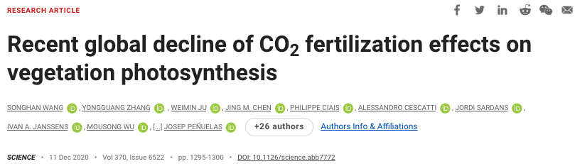
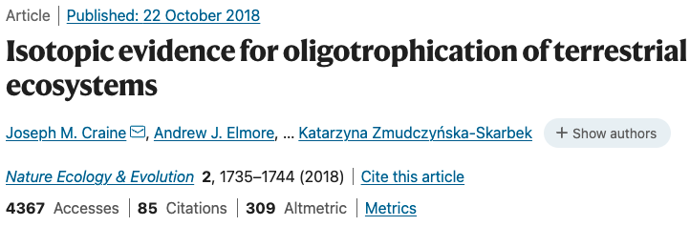
Leaf N is decreasing with elevated CO₂
nick.smith@ttu.edu; @nick_greg_smith
Average: 0.2 to 0.25% year⁻¹

Slide 3
Leaf N demand decreases with increasing CO₂
nick.smith@ttu.edu; @nick_greg_smith
Dong et al. (2022)

Slide 4
Leaf N demand decreases with increasing CO₂
nick.smith@ttu.edu; @nick_greg_smith
Smith and Keenan (2020)

Slide 5
Eco-evolutionary optimality theory can predict CO₂-induced reductions in leaf N
nick.smith@ttu.edu; @nick_greg_smith
Model: Dong et al. (2022)
Data: Zheng et al. (2019)

Slide 6
Eco-evolutionary optimality theory can predict CO₂-induced reductions in leaf N
nick.smith@ttu.edu; @nick_greg_smith
Smith and Keenan (2020)

Slide 7
What do reductions in leaf N demand mean for ecosystem C-N dynamics under future, elevated CO₂?
nick.smith@ttu.edu; @nick_greg_smith

Slide 8

ELM simulations
nick.smith@ttu.edu; @nick_greg_smith
All simulations included optimal V_{cmax} and J_{max} (Smith and Keenan, 2020)
All simulations included dynamic carbon and nitrogen allocation (Zhu et al., 2019)
2 simulations with different N dynamics
Leaf N is determined by N availability in soil
Leaf N is determined by N demand for photosynthetic biochemistry

Slide 9
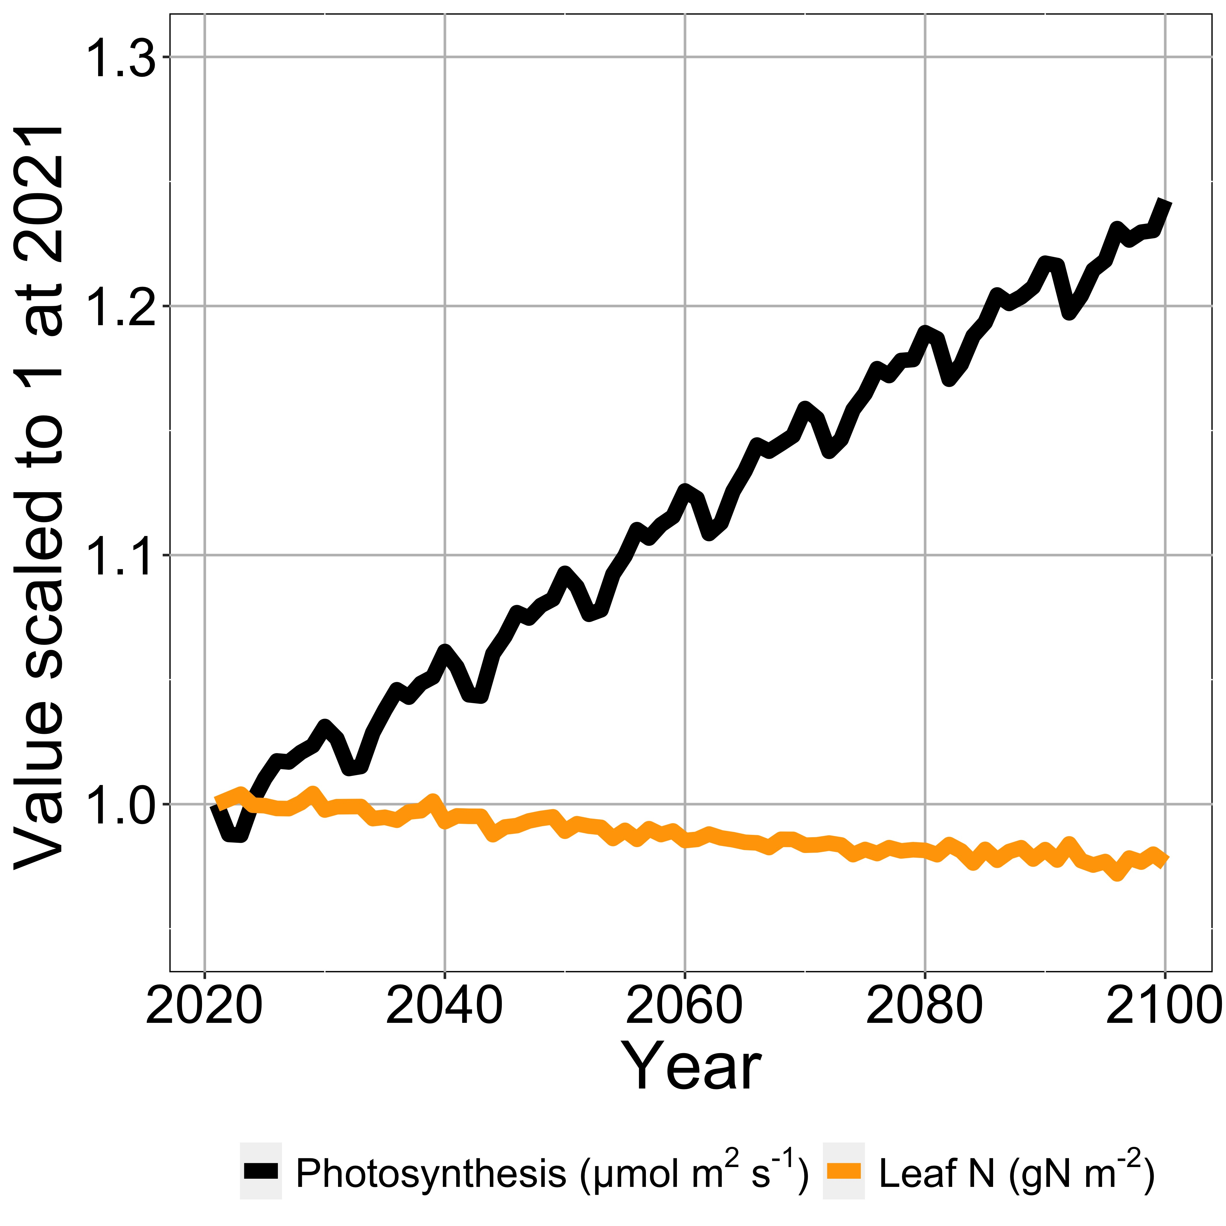
Result 1: Photosynthesis increases with elevated CO₂ at lower leaf N
nick.smith@ttu.edu; @nick_greg_smith

Slide 10
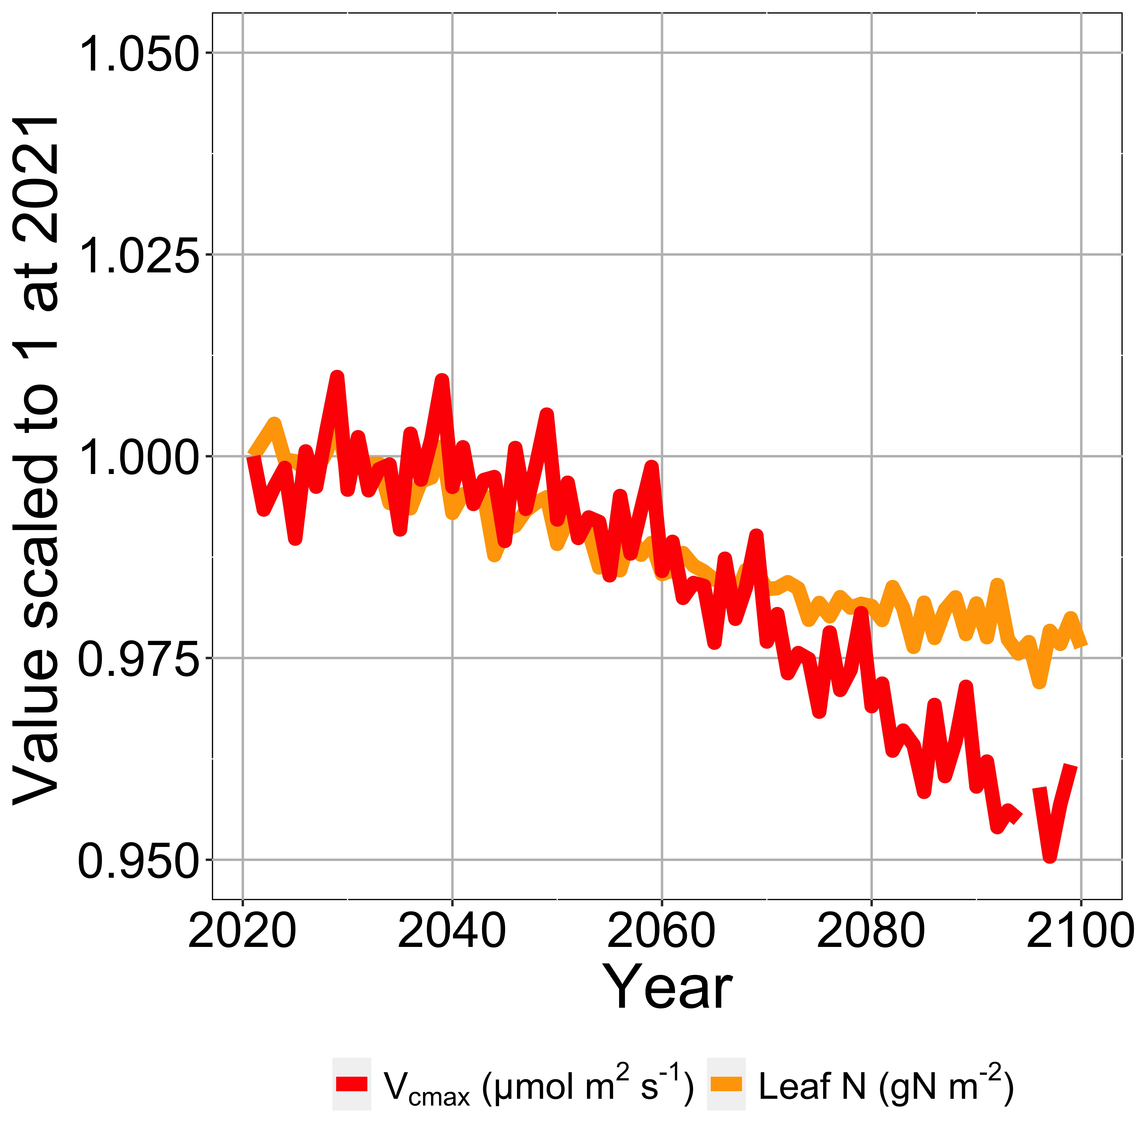
Result 1: Leaf N reduction is due to a reduction in photosynthetic capacity
nick.smith@ttu.edu; @nick_greg_smith

Slide 11
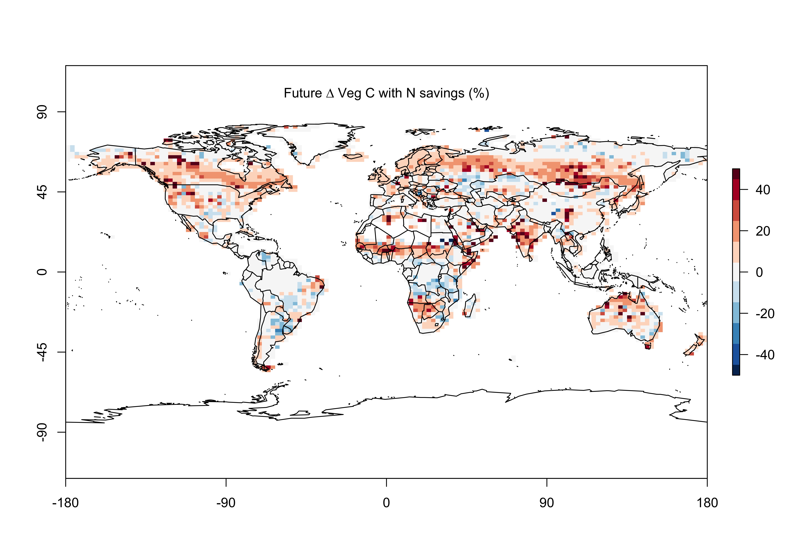
Result 2: Leaf N savings increases plant growth
nick.smith@ttu.edu; @nick_greg_smith

Slide 12
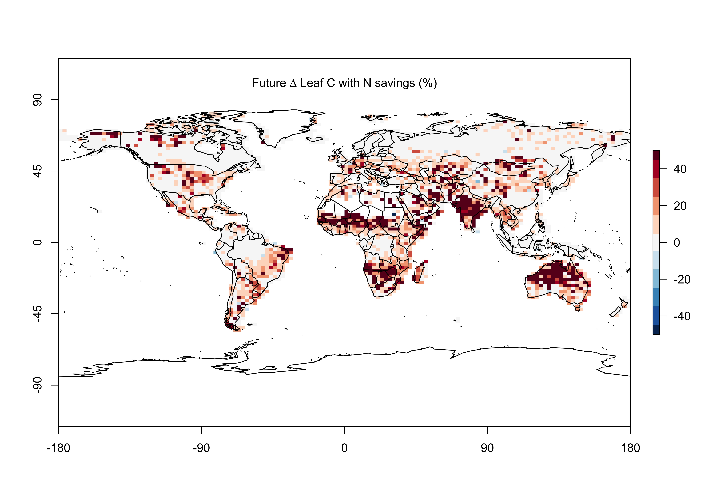
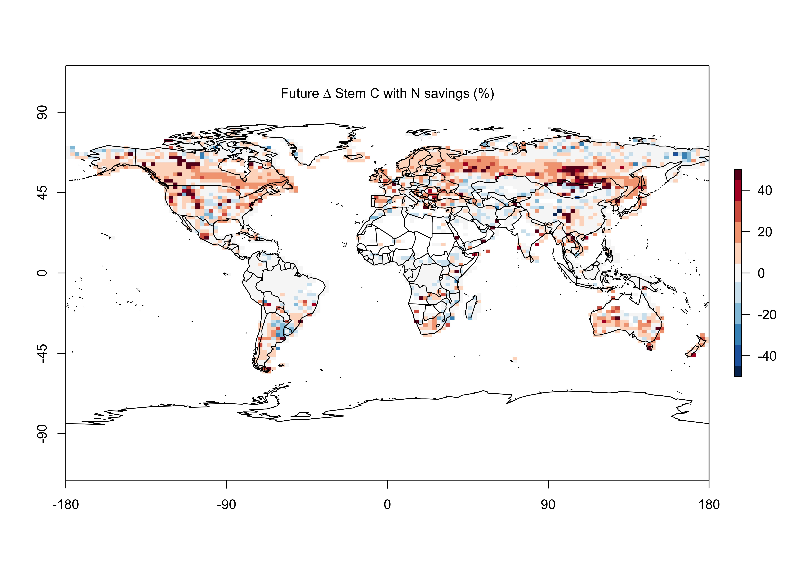
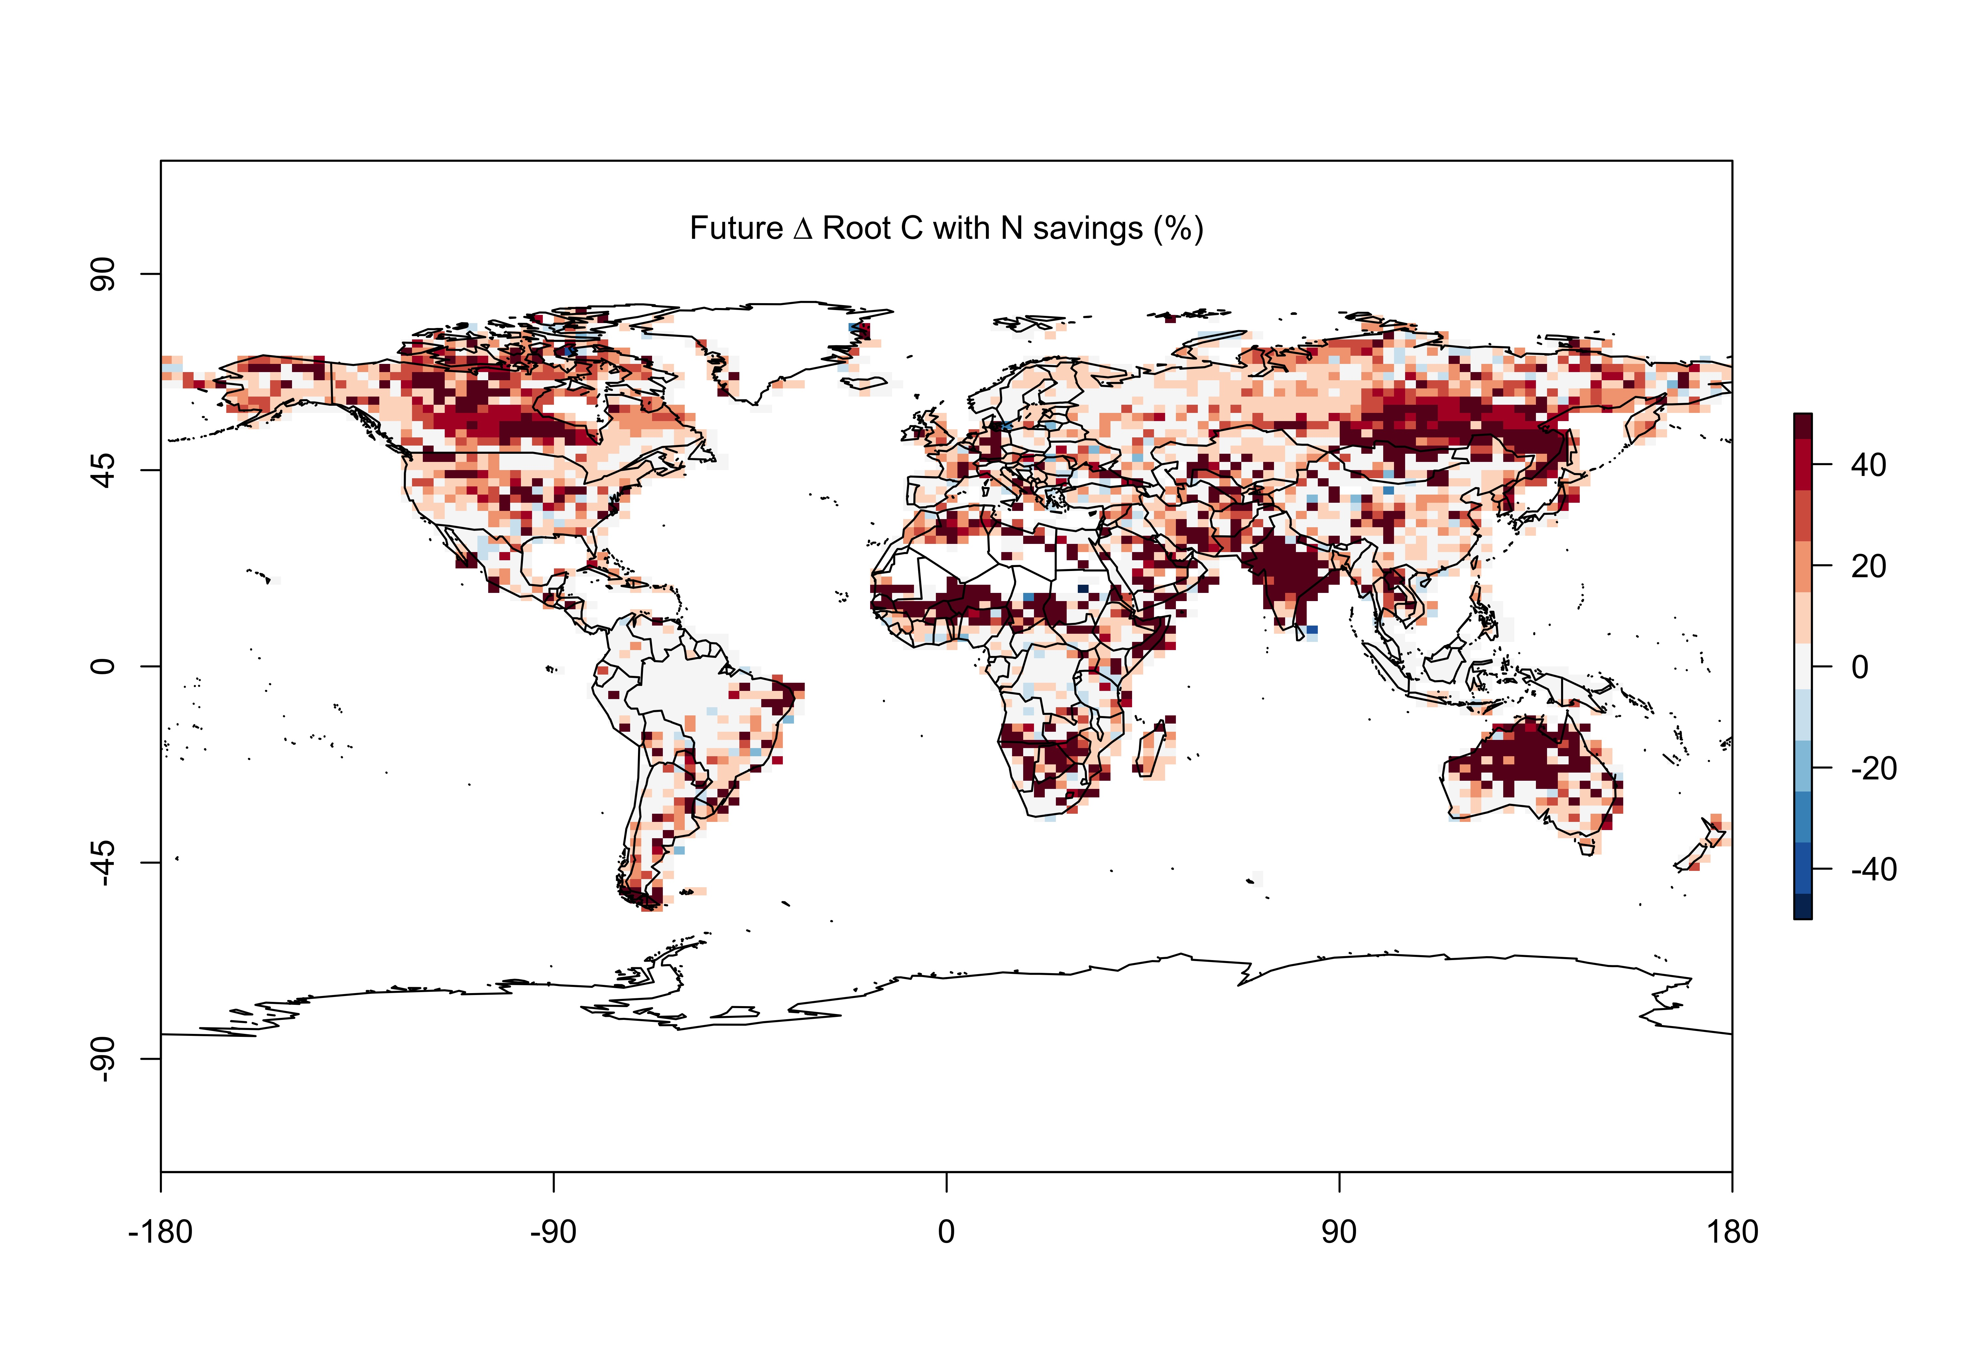
Result 2: Leaf N savings increases plant growth…most in leaves and roots
nick.smith@ttu.edu; @nick_greg_smith

Slide 13
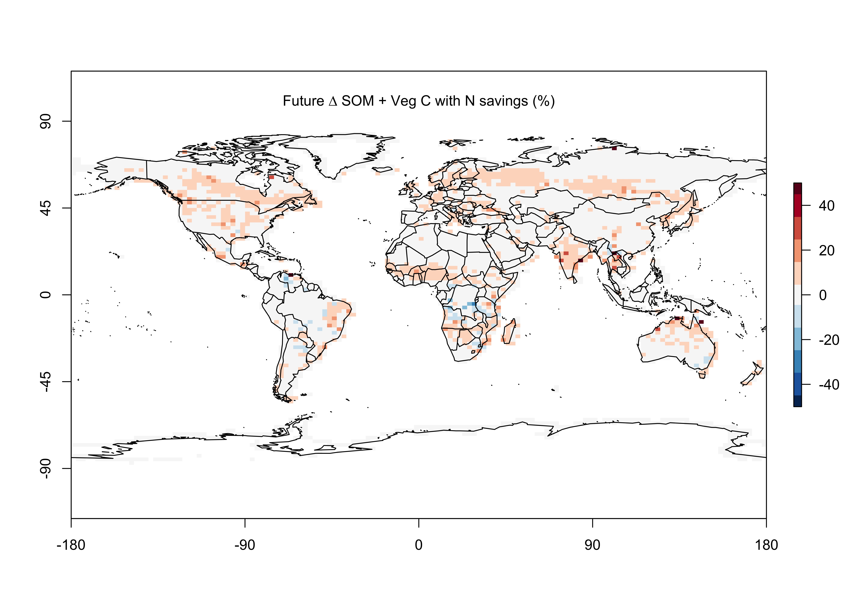
Result 3: Leaf N savings increases long-term ecosystem carbon stocks
nick.smith@ttu.edu; @nick_greg_smith

Slide 14
What does this all mean?
nick.smith@ttu.edu; @nick_greg_smith

Slide 15
Future progressive nutrient limitation may be overestimated
nick.smith@ttu.edu; @nick_greg_smith
“No limitation” simulation
“Nutrient limitation” simulations
Weider et al. (2015)

Slide 16
Conclusions
nick.smith@ttu.edu; @nick_greg_smith
Photosynthetic N demand is reduced under future elevated CO₂ and temperature
Least cost optimality theory can predict this
The theory can (and should) be incorporated into ESMs
No added parameters
N savings increases projected ecosystem C
Progressive nitrogen limitation may not be as strong as current models predict

Slide 17



nick.smith@ttu.edu; @nick_greg_smith
Presentation available at:
www.github.com/SmithEcophysLab/seminar/egu_2022
Thanks!

